Slide 1

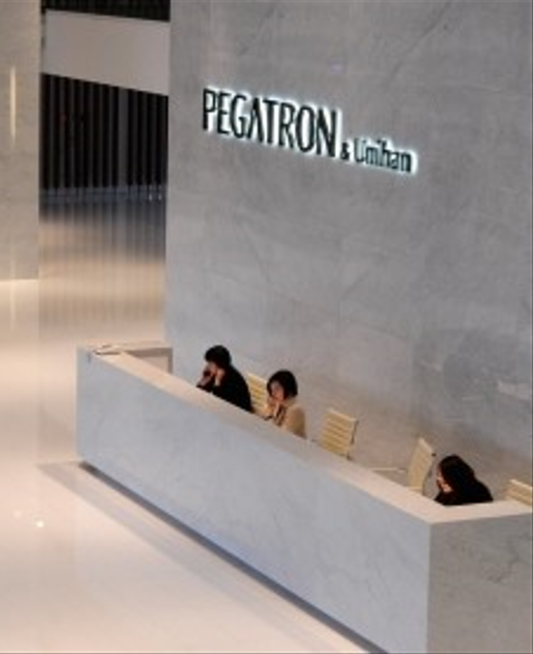


BG6
PVN
2026 PVN FME Q3 工作報告
部門: (PVN)第六事業群-製造及營運管理中心-越南製造處-PVN1廠-FME部-自動化課
姓名: Leon_Than
職等: 19
日期: 2026/09/18
FME
BG6 PVN

Slide 2
BG6
PVN
2026年度Q2-Q3工作成果
Time | Work Result
2026 Q2 | 1. Continue complete unfinished AOI Projects at F5-4F of Q1-2026.
 | 2. Complete new AOI External projects at F5-4F. Improve missing component issue and detect function.
 | 3. Add new function, optimize working time for all AOI External stations at F5-4F.
 | 4. Setup station and build up program for AOI External stations at F5-5F.
2026 Q3 | 5. Add new function, prevent OP make incorrect actions and arrange products not according to SOP at Station K10-AOI Carton Machine of 4K-Panasonic
 | 6. Build up and testing new program for the AOI Carton for Yamaha series in line 4K.
 | 7. Build up and testing new program for the AOI Giftbox for Yamaha series in line 4K.
 | 8. Manage and organize human resources of Software and Vision Team. Ensure production and customer requirements. Meet automation needs.
 | 9. Continue perform plans and goals for the F5-5F AOI External Station.
FME
BG6 PVN

Slide 3
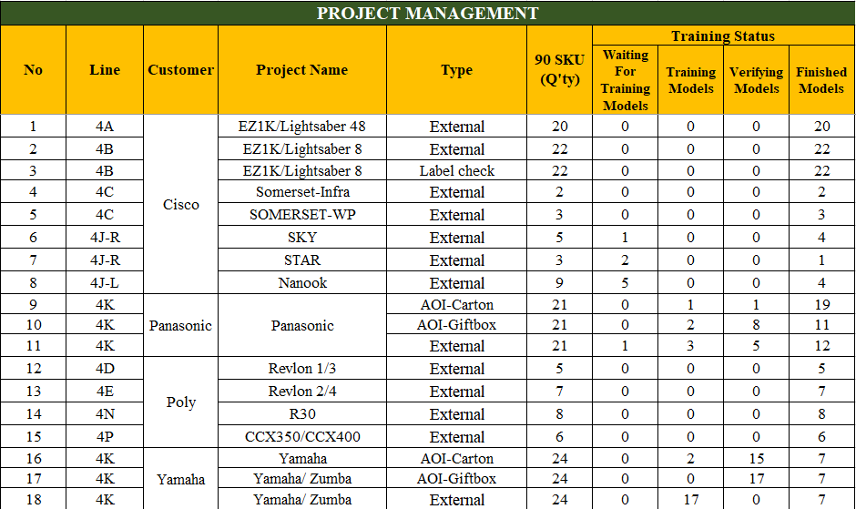
BG6
PVN
Detailed description of work results
1. Continue complete unfinished AOI Projects at F5-4F of Q1 - 2026.
Project Process :
EZ1K/Lightsaber Series : Completed AOI External and Label Check projects.
Somerset Series : Somerset-Infra and Somerset-WP projects are completed.
Sky/Star/Nanook Series : Projects are in progress, mainly waiting for training models.
Panasonic Series : AOI Carton, AOI Giftbox and External projects are under training and verification
Revlon/R30/CCX Series : Most projects have been completed.
Yamaha/Zumba Series : Projects are currently in training and verification stages
Quanlity
Ensured defect detection accuracy and stable inspection results.
Continued training and verifying AI models for unfinished projects.

Slide 4
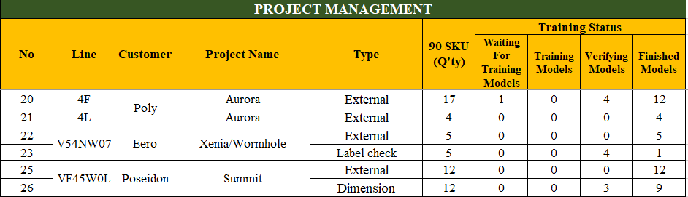
BG6
PVN
Detailed description of work results
1. Complete new AOI External projects at F5-4F and F5-5F. Improve missing component issue and detect function.
Project Process :
Eero Xenia/Wormhole: External project is completed ; Label Check is under verification.
Aurora Series : Most projects have been completed.
Summit Series :
Quanlity
Ensured defect detection accuracy and stable inspection results.
Continued training and verifying AI models for unfinished projects.

Slide 5
BG6
PVN
2026 Q4-2027 Q1 工作及自我發展計畫
時間 | 工作及自我發展計畫
2026 Q4~
FME
BG6 PVN

Slide 6
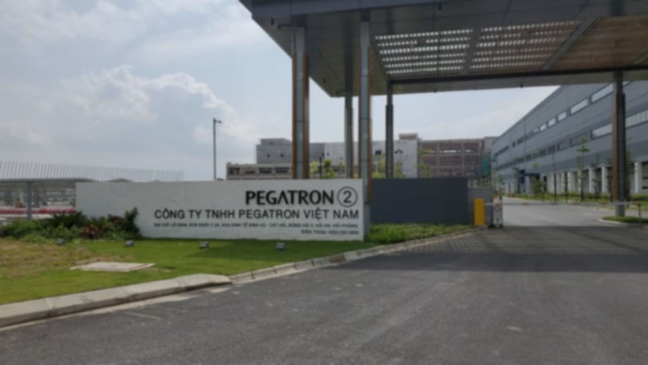
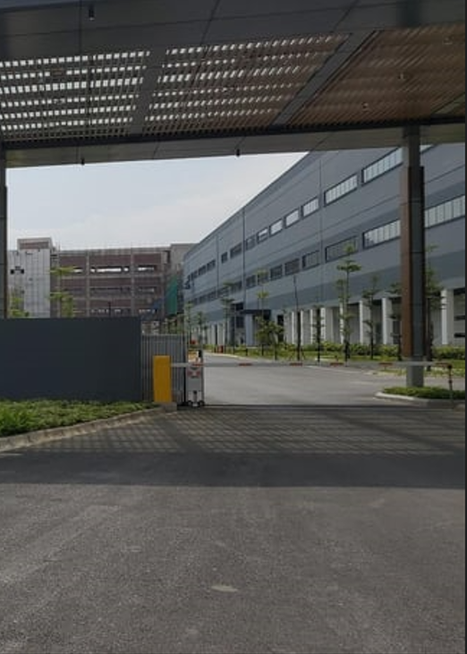
Thank You

